Slide 1
Congestion Notifier Service

Slide 2
Table of contents
Introduction
Service Introduction
Why we made this service?
2. Technical Part
- Arduino
Firebase
Main Process
3. Our web
Bootstrap
Responsive web
4. Video for Demo

Slide 3
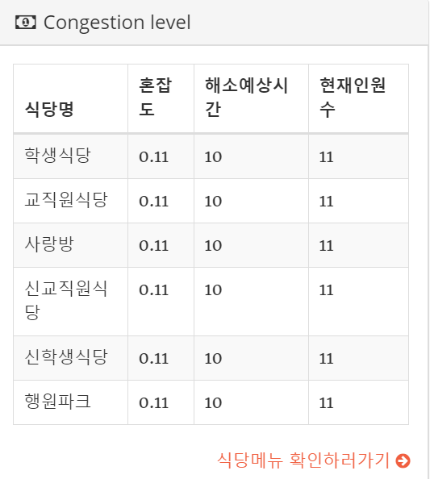
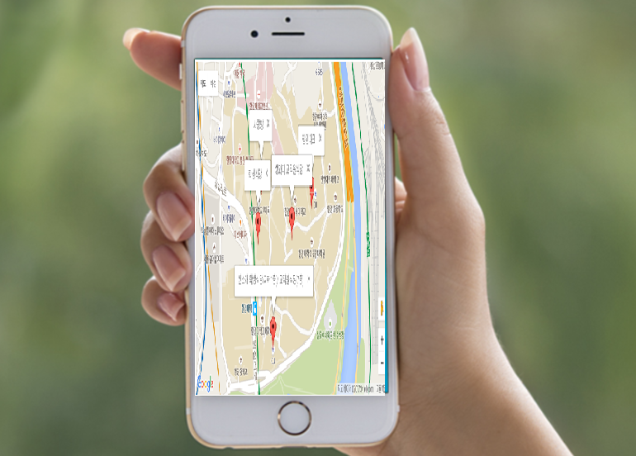
Service Introduction
This service show real-time congestion of the place

Slide 4
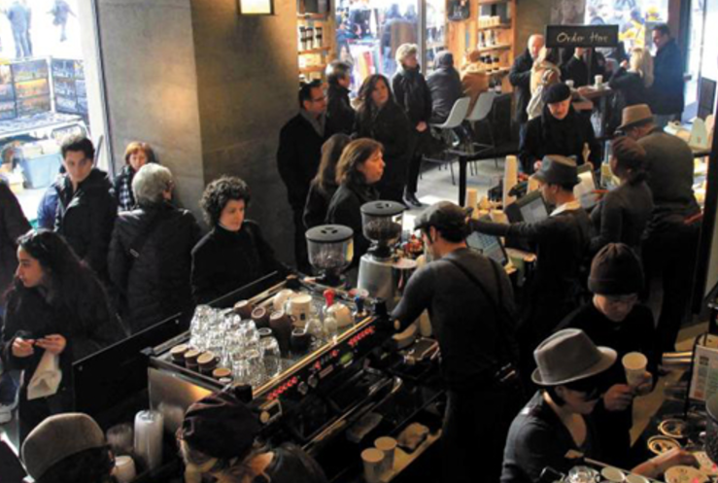
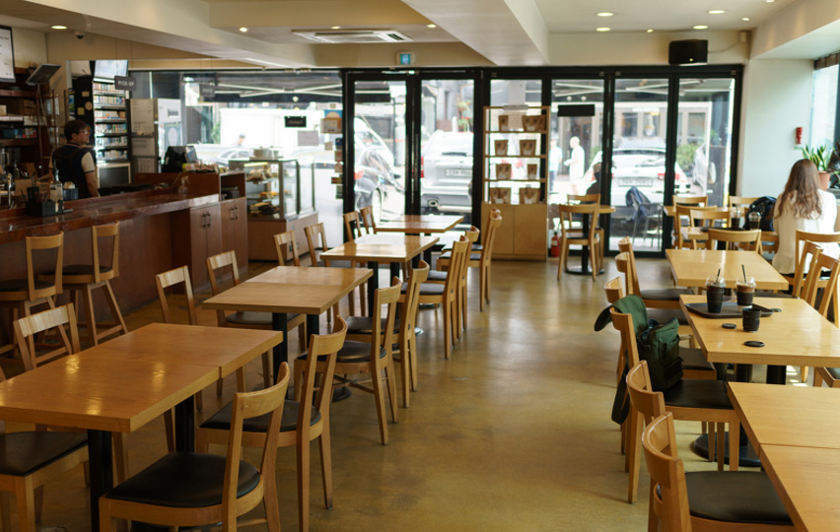

Why do we make this service?
Crowded Cafe
Quite Cafe
How can we find café available?

Slide 5
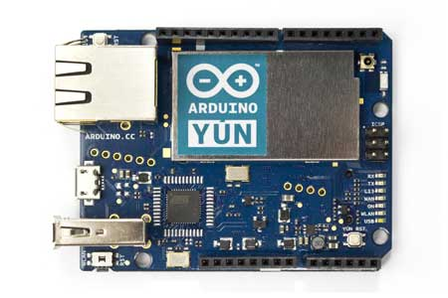
Arduino yun
Best for Wireless communication
ability to communicate with the Linux distribution onboard, offering a powerful networked computer with the ease of an Arduino.

Slide 6

Firebase Real-time Database
The Firebase Realtime Database is a cloud-hosted database. Data is stored as JSON and synchronized in realtime to every connected client.

Slide 7
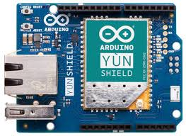

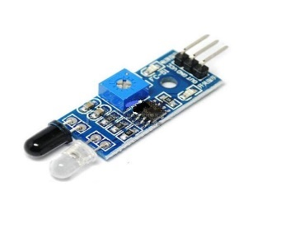
Main Process
→ For data communication
Delivering sensor value
Firebase RealtimeDatabase
Delivering sensor value
arduino yun
Delivering sensor value
Infrared sensor
Our web application

Slide 8
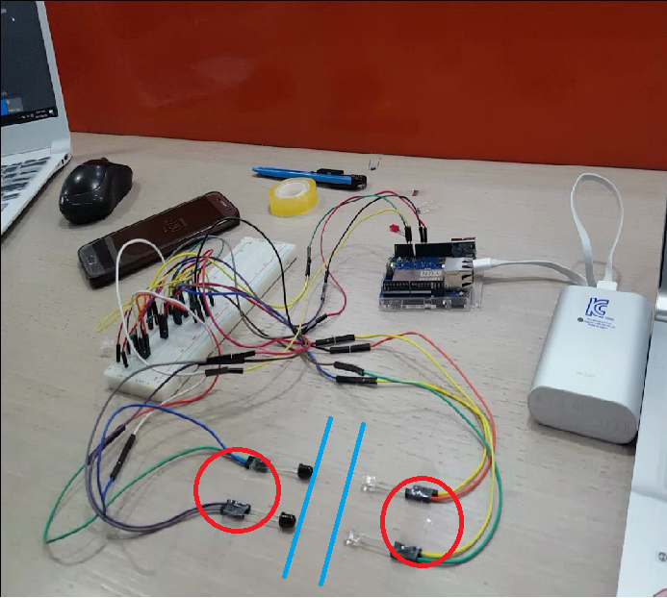
The actual circuit of Arduino yun
Infrared sensor
Path

Slide 9
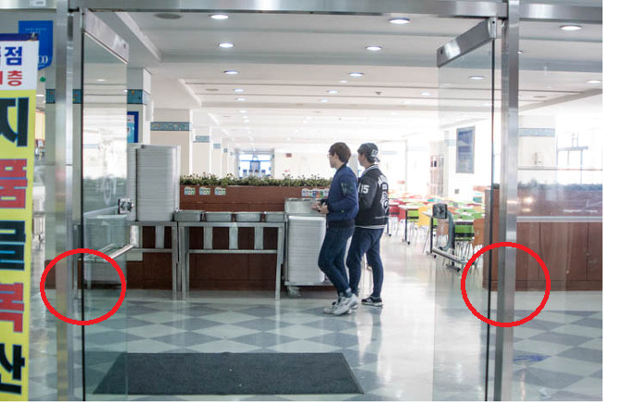
University Restaurant’s Door
Infrared sensor
Infrared sensor

Slide 10
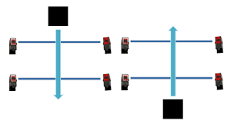
Infrared sensor in hardware circuit
If people get into space ,Sensor value will increase
If people get out space , Sensor value will decrease

Slide 11
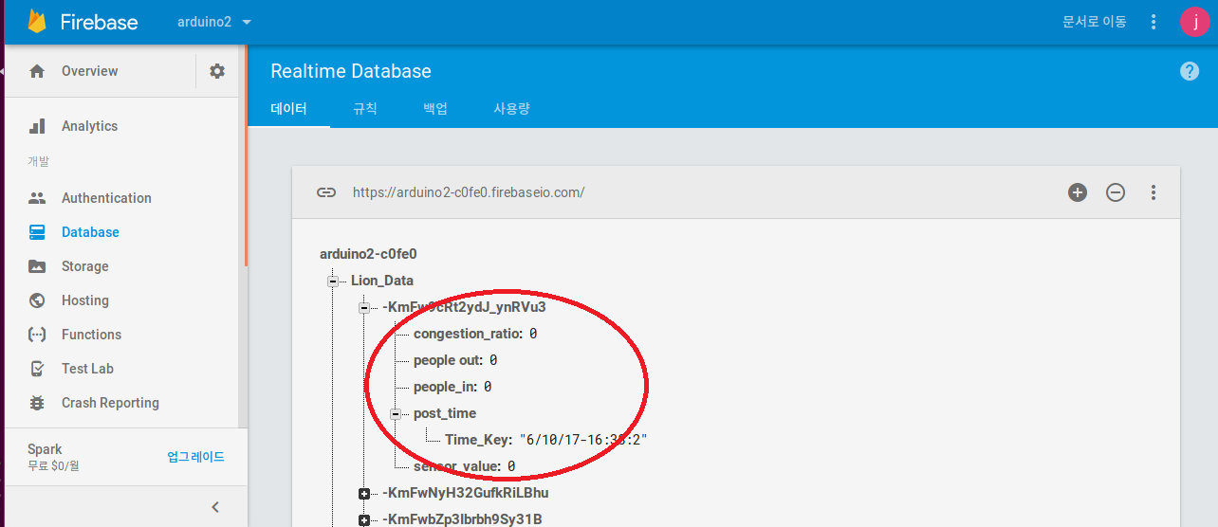
Firebase Real-time Database console
Data delivered by Arduino yun

Slide 12
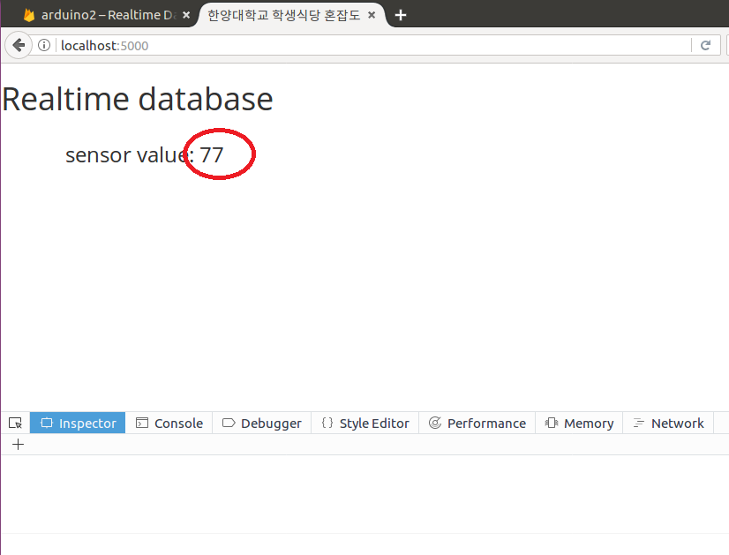
Web application
Data delivered by Friebase realtime database
Notes:
https://arduino2-c0fe0.firebaseapp.com/
https://firebase.google.com/?hl=ko

Slide 13
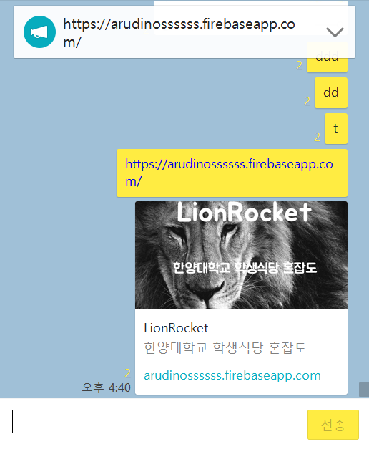

Our web
https://donwork-233dd.firebaseapp.com/
Notes:
https://donwork-233dd.firebaseapp.com/

Slide 14
Video
Video part

Slide 15
THANK YOU.

